Slide 1


Multi-Class Match Result Prediction Using Multinomial Logistic Regression
1
Y. Venkata Sai
D. Tejas
2520030278
2520030407

Slide 2
Introduction
2
Predicting the outcome of a cricket match is valuable for fans, analysts, coaches and sports organizations.
Match results depend on many factors: team performance, venue, toss result and recent form.
Traditional predictions rely heavily on expert opinion and simple historical statistics.
These approaches may not capture complex patterns across team form, venue and toss outcome.
Our project uses Machine Learning to analyze cricket match data and predict the likely result.
The proposed model is Multinomial Logistic Regression, which supports multi-class outcomes: Win, Loss, or No Result.

Slide 3
Problem statement
3
Analysts and fans have difficulty predicting cricket match outcomes using traditional approaches such as:
Expert opinion
Manual statistical analysis
Simple historical averages
These approaches may not capture complex, multi-factor patterns early enough to give a reliable, data-driven prediction.
Main Goal:
To develop a Machine Learning system that analyzes cricket match data and predicts the match result
— Win, Loss, or No Result — giving fans, analysts and organizations a reliable, data-driven prediction tool.

Slide 4
Objectives
4
Collect relevant cricket match data for outcome prediction.
Understand and analyze the match dataset.
Clean and preprocess the collected data.
Perform Exploratory Data Analysis (EDA) to identify patterns related to match results.
Develop a Multinomial Logistic Regression model.
Evaluate the model using appropriate performance metrics.
Provide a system that predicts match outcome (Win / Loss / No Result) and outcome probability.

Slide 5
Dataset Overview
5
Dataset Used: Cricket Match Dataset (Cricket Data API / Sports API)
The dataset contains match information collected through a Cricket Data API / Sports API.
It includes details about team performance, runs scored, wickets, venue, toss result, recent form and player statistics.
Our target variable is Match Result, which tells us the outcome of a match.
The target has three classes: Win, Loss, and No Result.
This is a Supervised Learning → Multi-Class Classification problem.

Slide 6
Step 1 Load Dataset Import Libraries
6
import pandas as pd import numpy as np
import matplotlib.pyplot as plt import seaborn as sns
from sklearn.linear_model import
LogisticRegression
Library | Purpose
Pandas | Load and manipulate the dataset
NumPy | Numerical calculations
Matplotlib | Create graphs and visualizations
Seaborn | Create statistical visualizations
Scikit-learn | Build the Multinomial Logistic Regression model

Slide 7
Loading the Dataset
7
Loading the Dataset
from google.colab import files upload = files.upload()
Check Dataset Size
print("Rows:", df.shape[0])
print("Columns:", df.shape[1])
Display the Dataset
df.head()
This displays the first 5 rows of the dataset.
Rows: 1200
Columns: 18
Check Column Names
print(df.columns.tolist())

Slide 8
Step 2 Data Understanding
8
Check Statistical Summary
df.describe()
Check Missing Values & Duplicate Values
df.isnull().sum()
df.duplicated().sum()
Understand the Target Variable
df["Match Result"].value_counts()
This gives statistical information for numerical columns such as:
Count
Mean
Standard deviation
Minimum
Maximum
Quartiles
Match Result | Count
Win | 620
Loss | 540
No Result | 40

Slide 9
Step 3 Data Cleaning
9
Correct Data Types
df["Toss Result"].dtype
df["Toss Result"] = pd.Categorical(...)
Remove Irrelevant Columns
columns_to_drop = [ "Match ID", "Player of Match", "City",
"Date",
"Umpire 1",
"Umpire 2"
]
In this dataset, Toss Result and Venue may be stored as text and need to be encoded before modeling.
These columns don't provide useful predictive information for our match-outcome modeling objective.

Slide 10
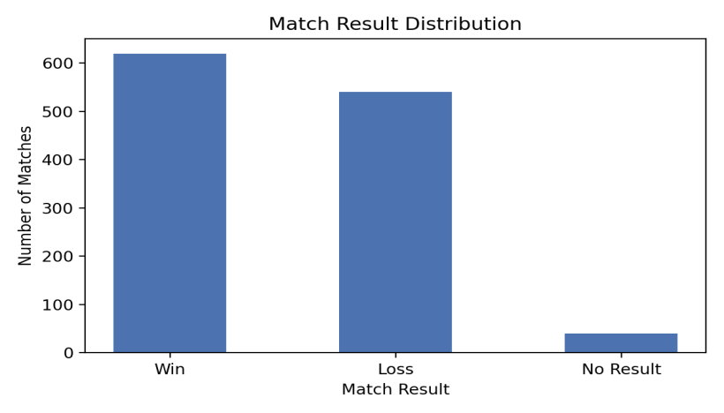
Step 4 EDA
10
To understand the proportion of Win / Loss / No Result
matches.
plt.figure(figsize=(6, 4)) sns.countplot(data=df, x="Match Result") plt.title("Match Result Distribution") plt.show()
Match Result vs Toss Result
plt.figure(figsize=(8, 5))
sns.countplot(data=df, x="Toss Result", hue="Match Result")
plt.title("Result by Toss Outcome") plt.show()
We analyze whether the match result differs based on:
Winning the toss vs losing the toss
Choosing to bat first vs field first
Home venue vs away venue

Slide 11
EDA – Exploratory Data Analysis
Understand the Dataset: Check rows, columns, data types, missing values and duplicates.
Target Distribution: Compare Win, Loss and No Result using a count plot.
Toss vs Match Result: Analyze whether toss outcome and decision are associated with the match result.
Recent Form Analysis: Compare recent-form scores across Win, Loss and No Result using a box plot.
Correlation Analysis: Use a heatmap to study relationships among numerical variables such as runs, wickets and recent form.
Purpose of EDA: Find patterns, detect data issues and understand useful features before model training.

Slide 12
Result vs Recent Form
Correlation Heatmap
11
# result vs recent form plt.figure(figsize=(8, 5))
numeric_cols = df.select_dtypes(include=np.number).columns
sns.boxplot(data=df, x="Match Result", y="Recent Form Score")
plt.title("Result vs Recent Form") plt.show()
correlation = df[numeric_cols].corr() sns.heatmap(correlation, annot=True, cmap="coolwarm") plt.show()
We compare the recent-form distribution of:
Winning teams
Losing teams
To understand the relationships between numerical variables such as runs, wickets and recent form.
Thank You

